Slide 1
Time Clocks: It’s Time for Marathon HR

Slide 2
TIME CLOCKS EASE OF COMPLIANCE
Requirements of the Fair Labor Standards Act (FLSA): | Time clocks help employers keep compliance by:
Maintain 14 types of different employee records including hours worked each day and week, overtime and wages earned | Streamlining and automating record keeping
Save payroll records for at least three years | Preserving data electronically; no paper files to manage
A time keeping plan that is “complete and accurate” | Diminishing human error in time accounting with comprehensive software and safeguards

Slide 3
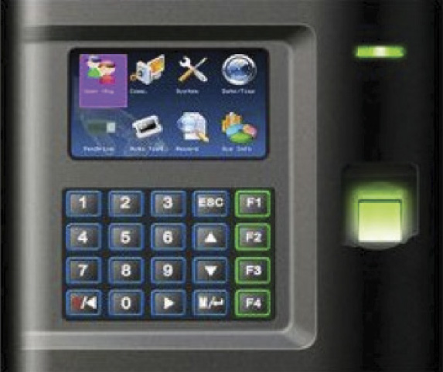
BIOMETRIC TIME CLOCK
Prevents “buddy punching”; employee can’t clock in or out for someone else
Uses finger print, palm print, retina scan, vein scan (scans the vein in your finger)
No time card to keep track of

Slide 4
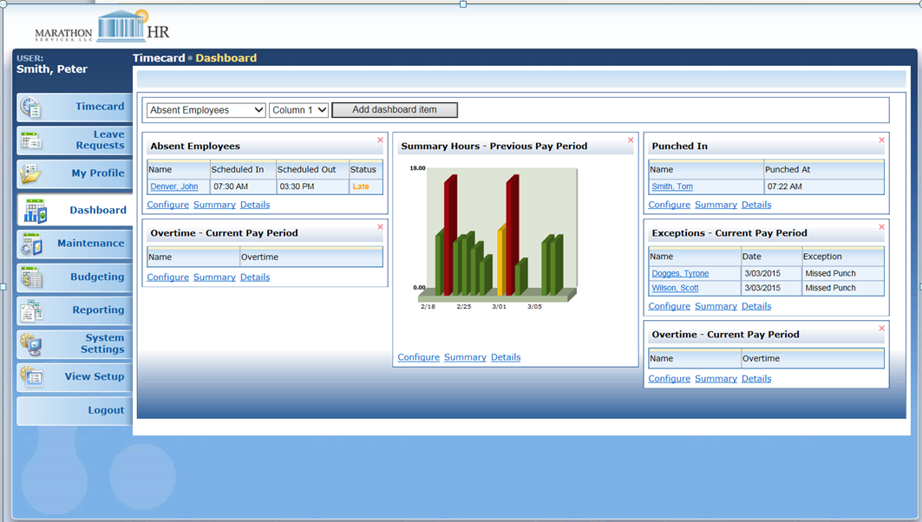
WEB BASED TIME CLOCK
Employee, employer and Marathon HR may access data from anywhere
Multiple parties can manage the clock to ensure accurate time punches and quickly correct errors
View time clock at any time

Slide 5
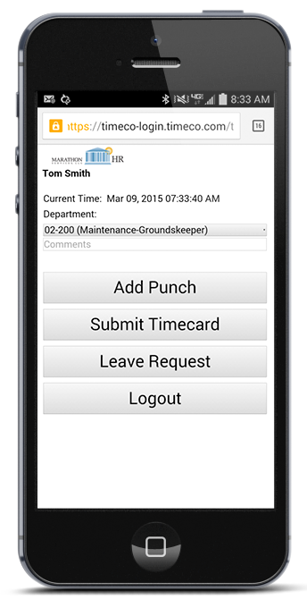
MOBILE APP TIME CLOCK
Great for remote employees and those that travel
Leverage GPS coordinates to confirm location where work is performed
Fully integrated with Marathon HR’s payroll software; export data easily into payroll system

